Slide 1
Lock and key
Jackson Warren

Slide 2
Big picture
Breathalyzer test combined with a lock for your glove box
Ensure safe driving
Accountability
An insurance policy

Slide 3
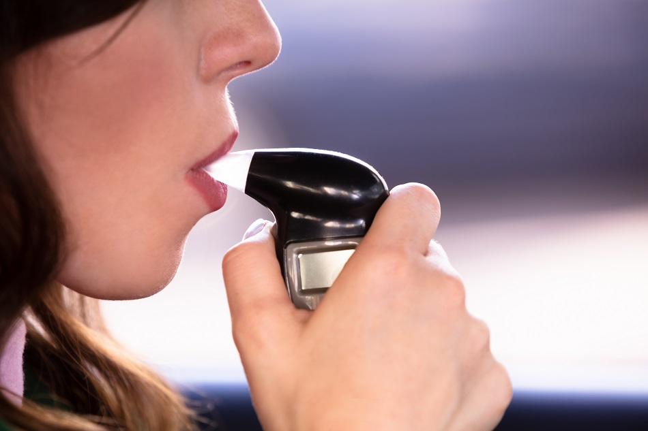
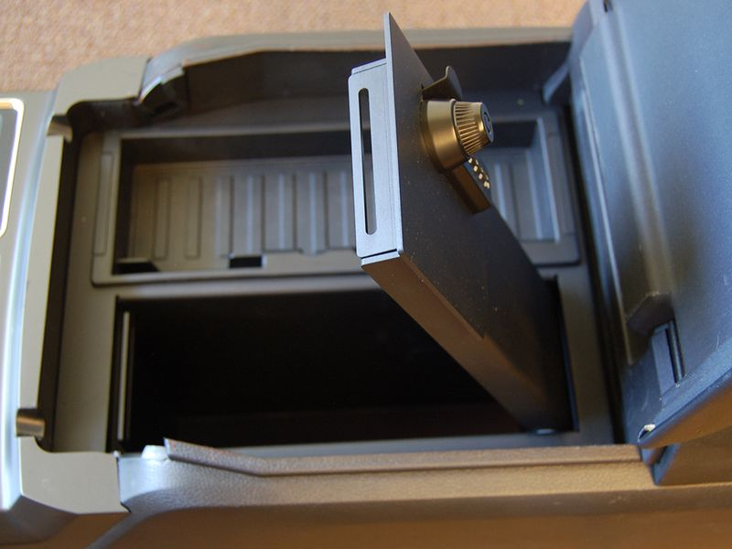
Equipment
Current knowledge and equipment is very limited…
Will need:
Breathalyzer
Electronic lockbox (car sized)
Lots of coding to learn…
How the devices communicate
CAN they communicate?
Sending signals from one device to another
Coding where both devices will be able to understand
Lots to learn!

Slide 4
Goals
Have a functioning system by the end of the semester. Perhaps not installed in an actual car, but a working hands on device.
Understand how to communicate through two different devices.
Coding knowledge.

